Slide 1
REACH
Juvenile Service Planning Committee (JSPC) + Interagency Oversight Group (IOG)
Pathways program of Joint Initiatives for Youth + Families

Slide 2
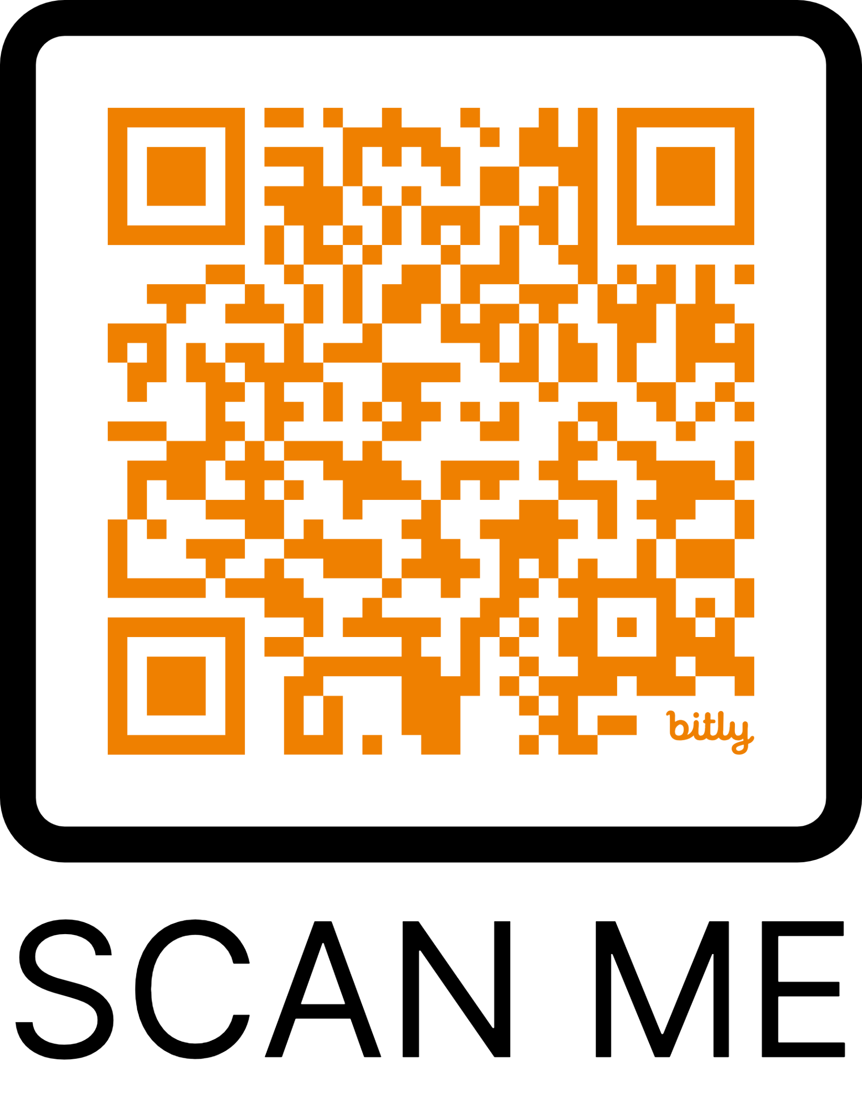
Agenda
REACH Committee Meeting
Wednesday, November 13, 2024
11:45 am – 1:15 pm
Virtual Sign-In
Welcome 5-10 minutes
Please put your name/organization in the chat!
HIGHLIGHTS:
Introductions/Ice Breaker
JAC Updates
Detention Screening Tool Launch
Policy Revision Workgroup
Schedule and ISST Referral Process
Detention Bed Cap Review
ERC Subcommittee Updates
December/January Schedule Update
Member Spotlight
4th Judicial District (CYDC/JSPC)
&
El Paso County
(CMP/IOG)
=
REACH

Slide 3
REACH Executive Team
Chair Jennifer Hernandez – Juvenile Probation
Vice-Chair Tina Horton – 4th Judicial District
Past IOG Chair Catania Jones – Director CY&FS
Past JSPC Chair Andrew Prehm – Bureau Chief Sheriff’s Office
Judge/Magistrate Magistrate Candea-Ramsey
At-Large Member Angela Rose – CASA Executive Director
At-Large Member Maria Black – Special Education D-11
Joint Initiatives Member SherryLynn Boyles – President/CEO JI
DYS Representative Kelly Crittenden, Program Manager/Clients Manager Supervisor
Private Citizen FY24-25 Open, one candidate potential
Interested in joining the team for FY24-25?
Contact: Jennifer Hernandez or Tina Horton.

Slide 4
JAC Update
JAC + Las Animas Office Progress
Significant improvements at JAC, including:
Deep-cleaned carpets, cleaned walls/surfaces, painted rooms, assembled furniture
Repurposed furniture from Galileo for cost-effectiveness
Features of JAC:
Multi-purpose space, co-working area, reservable meeting rooms
Dedicated areas for shelter youth and after-school programs
Opening Events:
Soft opening on November 4th, grand opening on December 2nd
Design Theme:
Nature-inspired aesthetic; working with a local organization for a hallway mural
Naming Feedback:
"Basecamp at Galileo" was considered, but received mixed feedback for sounding militaristic; alternative names are under consideration
REACH Committee Meeting | November 2024

Slide 5
JAC Update
JAC + Las Animas Office Progress
Las Animas Office Space
Fully set up for office use and available for reservations
Holiday open house is planned for December to welcome partners to the space
Shelter Updates
Construction plans were submitted and approved to the Downtown Review Board, with the goal of occupying the building by December.
Collaboration with Licensing, Health, and Fire departments to meet requirements.
REACH Committee Meeting | November 2024

Slide 6
Detention Screening Tool Launch
Dates are subject to change, weather permitting.
REACH Committee Meeting | November 2024

Slide 7
Policy Revision Work Group
Establish a team focused on the policy for screening juveniles for detention placement and risk assessment
Targeted rollout in February 2025
REACH Committee Meeting | November 2024

Slide 8
Referral Process
▶ View flyer HERE.
REACH Committee Meeting | November 2024

Slide 9
Review of CYDC/Detention Bed Cap
El Paso County CMP
FY24-25 MOU Partners
EPC DHS
4th JD Probation
4th JD District Court
El Paso County Public Health
Colorado Springs School District 11
Diversus Health Mental Health
Diversus Health Alcohol & Drug Treatment
Colorado Community Health Alliance
Division of Youth Services
TESSA
CASA
Joint Initiatives
Family Member – Sandra Kwesell
Review of CYDC/Detention Bed Cap
Updates presented by Andy Prehm and Al Estrada
REACH Committee Meeting | November 2024

Slide 10
ERC Subcommittee Updates
FY24-25 JSPC Members
Betty Smith/Joanie Lewis
Lori Stalcar
Tonya Ingram
Rebeka Whitney
Andy Prehm
Oliver Robinson SherryLynn Boyles
Judge Diana May
Kelly Hurtado
Magistrate-Candea-Ramsey
Marcy Palmer
Tina Horton
Nicole Schurbon
Kelly Crittenden
Ralph Parsons
Palmer Johnson
Ivett Ruiza
Eugene Moore
Cathy Cimino
Kevin Miyakusu
Jennifer Mussaw
Jennifer Hernandez
Seth Fischer
Maria Black
Catania Jones
Steffani Baker
Kristel Sharp-Limary
The subcommittee continues to review the ERC policy line-by-line.
Confidentiality issues around the ERC Live spreadsheet are being discussed, with acknowledgment of its creation during COVID for improved accessibility.
Other districts’ policies have been reviewed to assist in this process.
REACH Committee Meeting | November 2024

Slide 11
December + January Meetings
December:
In consideration of the holiday season, a proposal was made to cancel the December REACH meeting and hold only the Executive Team meeting.
January:
The REACH meeting would convene in January, and the Executive Team meeting would be canceled.
REACH Committee Meeting | November 2024

Slide 12
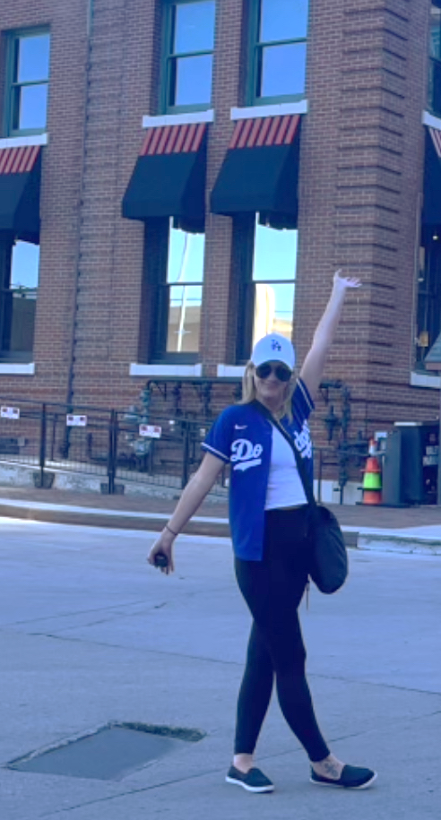
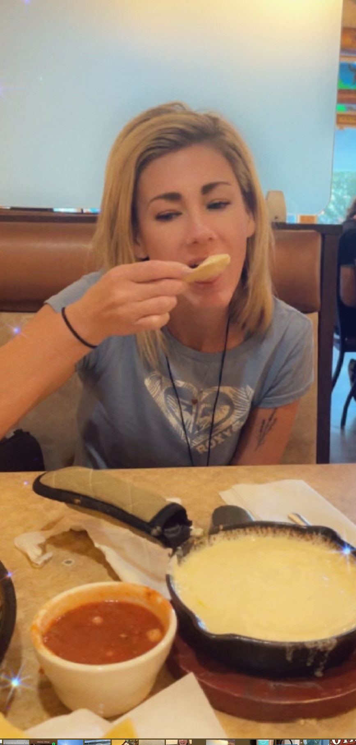
Member Spotlight | Meet Cassy
Hi everyone! I'm Cassy.
I’m a mom to two fantastic kids—Malia, who’s 14, and Cason, who’s 11. If you've ever joined a virtual call with me, you've probably also met my curious dog, Fern, who loves to make an appearance!
I'm a big baseball fan (Go Dodgers!—no judgment, please!), and I have an intense love for queso that I'm not ready to give up. On the healthier side, I’m all about meditation and cold plunging. Yes, I’m one of those people who willingly sits in ice water—it’s oddly refreshing!
From the moment I stepped into JI, it truly felt like home. I have a deep passion for working with youth and families, and JI has empowered me to bring that passion to life. I know I am exactly where I’m meant to be.
It’s a pleasure to serve alongside all of you.
REACH Committee Meeting | November 2024

Slide 13
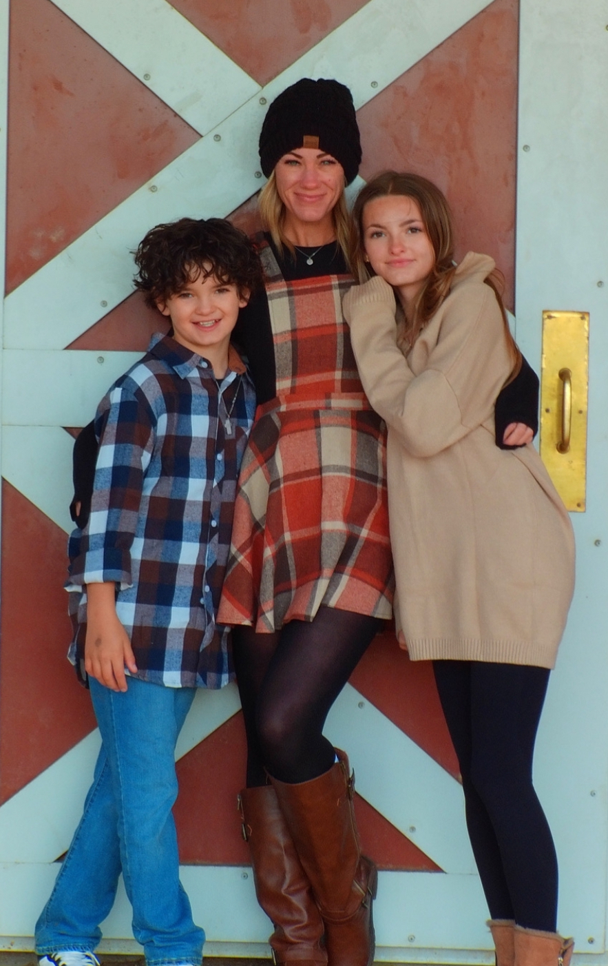
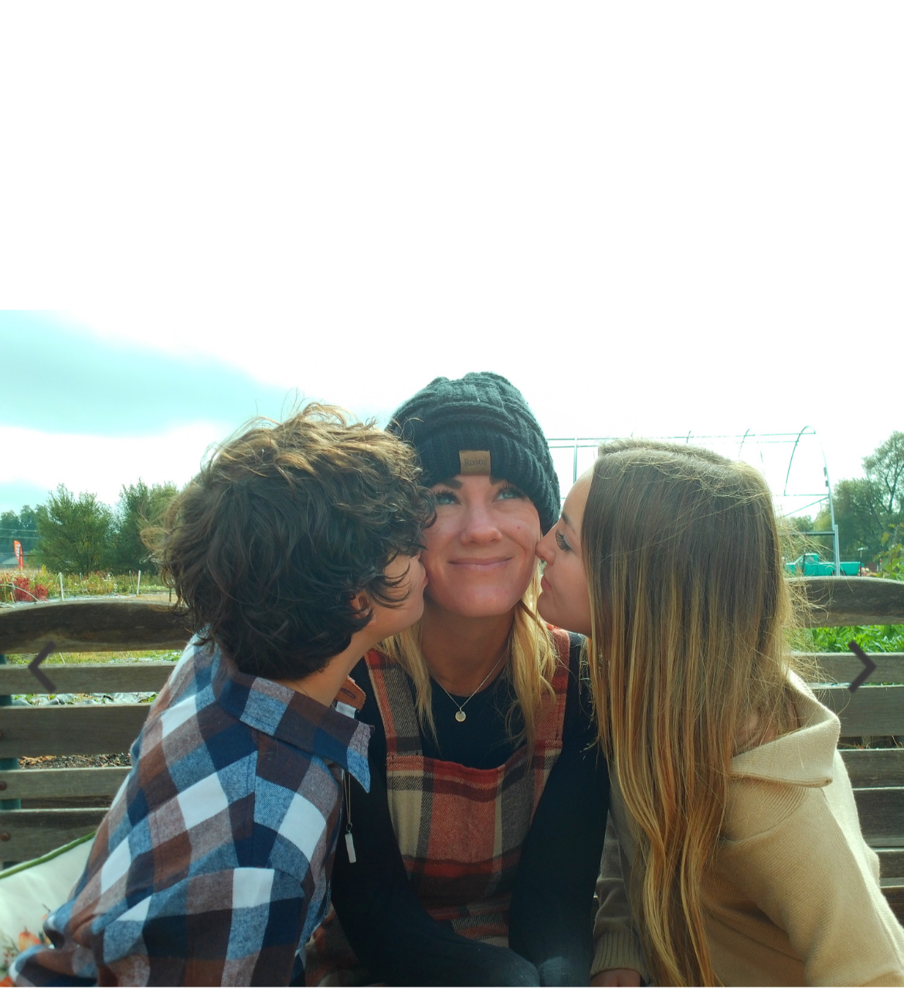
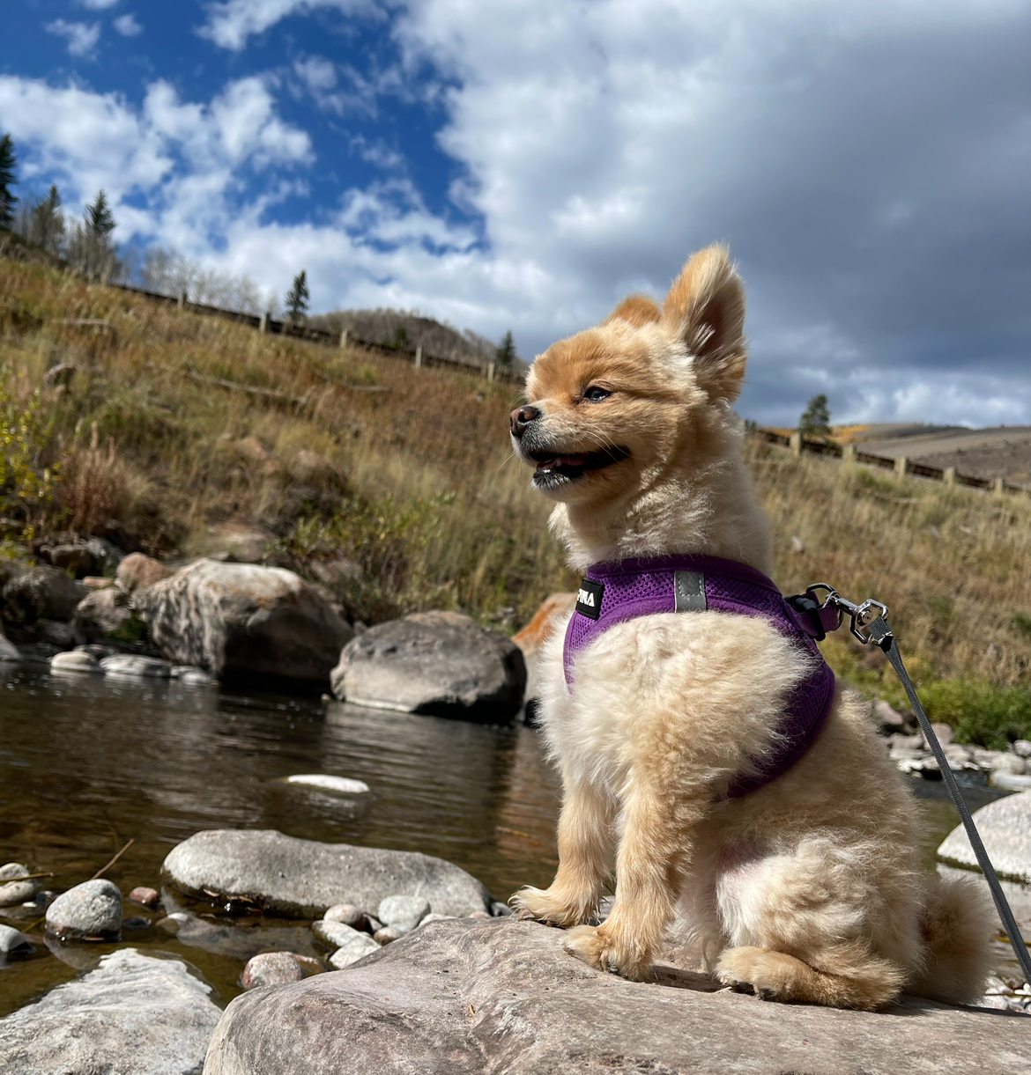
Member Spotlight | Meet Cassy
REACH Committee Meeting | November 2024

Slide 14
Questions?
Collaborative Management Program (CMP) and
Colorado Youth Detention Continuum (CYDC) are part of the
Pathways program of Joint Initiatives for Youth + Families

