Slide 1
Colorado Child Care Assistance Program (CCCAP)
Notes:
Tamara

Slide 2
Introductions
Tamara Schmidt
CCCAP Program Director
Danielle Greer
CCCAP Policy & Eligibility Administration Supervisor
Michelle Mackin-Brown
CCCAP Program Services Supervisor
Notes:
Tamara

Slide 3
CCCAP Mission & Purpose
The purpose of CCCAP is to provide eligible households with access to high quality, affordable child care that supports healthy child development and school readiness while promoting household self-sufficiency and informed child care choices.
Notes:
Danielle
The mission and purpose is supported by having :
12-month eligibility and redetermination periods
Processes to account for irregular fluctuations in earnings
Policies ensuring that families’ work schedules are not disrupted by program requirements
Policies to provide for a job search for each instance of non-temporary job loss
Policies to reduce the cliff effect
Procedures for the enrollment of families and children experiencing homelessness

Slide 4
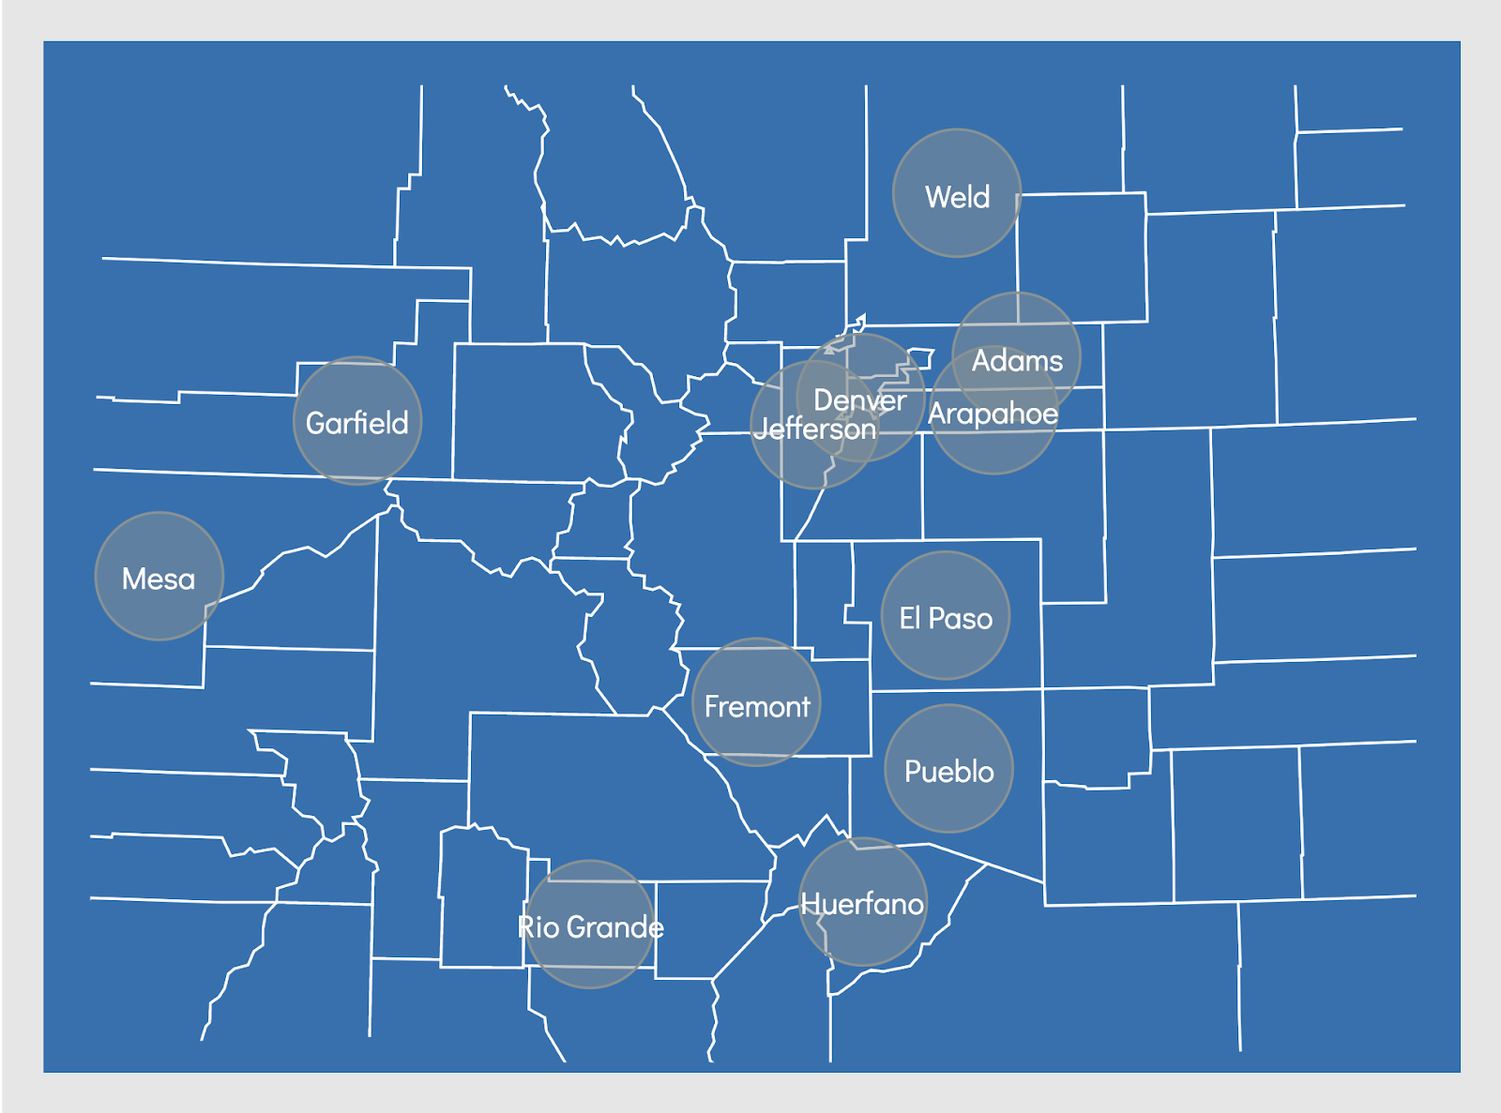
Garfield
CCCAP Administration Structure
State Supervised, County Administered
State and Federal funding allocated to counties for the administration of CCCAP.
County policies will vary across the state.
Notes:
Danielle

Slide 5
CCCAP Overview
Exploring program eligibility and processes.
Notes:
Danielle

Slide 6
Serves low-income families that are in an eligible activity
Low-Income CCCAP
Colorado Works CCCAP
Serves families that are participating in Colorado Works
Child Welfare & Protective Services CCCAP
Serves families that are involved in Child Welfare
Notes:
Danielle

Slide 7
Purpose:
To provide eligible households with access to high quality, affordable child care that supports healthy child development and school readiness while promoting household self-sufficiency and informed child care choices.
Eligible children:
Citizens or Qualified Aliens
Less than 13 years old or up to 19 years old with additional care needs
In the custody of Adult Caretakers or Teen Parents that are income eligible and are participating in an eligible activity*
Referral/application process: The family completes a Low-Income Child Care Application and submits it to the County of residence for processing
Special Considerations:
Families experiencing homelessness are provided a 60-day stabilization period that allows them extra time to enter into an activity and/or provide necessary verification.
*Income eligibility and eligible activity may vary by county
Low-Income Child Care
Serves low-income families that are in an eligible activity that are not participating in Colorado Works or engaged with Child Welfare
Notes:
Danielle

Slide 8
How to Apply
Online: Visit www.colorado.gov/peak to apply online. PEAK is a secure website run by the State of Colorado, and is available in both English and Spanish
In-Person: Visit local County Human Services office to apply
By Mail: Visit cdec.colorado.gov to download the application document and print, fax, mail or deliver it in-person to a County Human Services office. Applications are available in English and Spanish
Notes:
Danielle

Slide 9
Once an application has been received by the county:
CCCAP Application Process
01
The application is reviewed for completeness and families are given 15 days to return any additional verification that’s needed to determine eligibility.
Once the application is complete, CCCAP eligibility is determined based on all of the verification that is provided.
02
Counties are required to process applications within fifteen (15) days after the initial application is received.
03
If the family is eligible, care is authorized based on the care schedule that the family has requested.
04
Families are sent correspondence that notifies them of their care schedule and any parent fees that are owed to the provider.
Notes:
Danielle

Slide 10
Redeterminations are sent to families at least 45 days before they’re due. After the packet is returned to the county:
CCCAP Redetermination Process
01
The packet is reviewed for completeness and families are given 15 days to return any additional verification that’s needed to determine eligibility.
Once the redetermination is complete, CCCAP eligibility is determined based on all of the verification that is provided.
02
Eligibility is redetermined no sooner than every 12 months once a family is determined eligible for Low-Income CCCAP.
03
If the family is eligible, care is reauthorized based on the care schedule that the family has requested.
04
Families are sent correspondence that notifies them of their care schedule and any parent fees that are owed to the provider.
Notes:
Danielle

Slide 11
Colorado Works Child Care
Serves families that are participating in Colorado Works(TANF); a cash assistance program that helps eligible families with very low incomes become self-sufficient by encouraging job preparation, work and family stabilization.
Purpose:
To provide employed and work eligible Colorado Works participants with child care in order to participate in their activity.*
Eligible children: Citizens or Qualified Aliens that are in the custody of Adult Caretakers or Teen Parents that determined work eligible by Colorado Works.
Referral/application process: The county Colorado Works worker submits a referral on behalf of the family to the county Child Care technician for processing.
*Eligible activity is determined by the Colorado Works program
Notes:
Danielle

Slide 12
Child Welfare Child Care
Child Welfare & Protective Services Child Care
Purpose: To maintain children in their own homes or in the least restrictive out-of-home setting when there are no other child care options available while the family is receiving support to become stabilized and ensure safety of children that cannot remain in their home.
Eligible Children: Those residing in their biological home, with kin (kinship foster care or non-certified kinship care) or in a foster home.
Funding Source: Child Welfare Block Allocation
Referral/Application Process: The caseworker or designated child welfare staff completes the referral and submits it to child care for processing through CHATS.
Protective Services Child Care
Purpose: To provide child care services to child welfare resource families if the county chooses to utilize this option.
Eligible Children: Child(ren) that have been placed by the county in a foster home, kinship foster home, or non-certified kinship home and have an open child welfare case.
Funding Source: Child Care Development Fund (CCDF)
Referral/Application Process: The caseworker or designated child welfare staff completes the referral and submits it to child care for processing through CHATS.
Child care options for families engaged with Child Welfare
Notes:
Danielle

Slide 13
CCCAP Authorizations
Care is initially authorized based on the need indicated on the Low-Income Application or Redetermination, or the referral sent by Colorado Works or Child Welfare.
Care is authorized using the number of hours per day the family requests which translates to care units which are defined as:
Part-Time: One second through 5 hours
Full-Time: 5 hours and one second through 12 hours
Full-Time/Part-Time: 12 hours and one second through 17 hours
Full-Time/Full-Time: 17 hours and one second through 24 hours*
*Care provided cannot exceed 24 hours
Notes:
Danielle

Slide 14
Low-Income Child Care
Families request schedule changes by contacting their county’s CCAP team.
Colorado Works Child Care
Families communicate changes to their Colorado Works worker which are reported to the county CCAP team via Colorado Works Referral; or,
Families contact their county’s CCAP team. The county CCAP team will notify Colorado Works of the change in care schedule.
Child Welfare or Protective Services Child Care
Families communicate changes to their Child Welfare worker which are reported to the county CCAP team.
Requesting Authorization Changes
Changes must be requested by one of the caretakers on the CCCAP case.
Notes:
Danielle

Slide 15
Parent Fees
Families receiving Low-Income, Colorado Works, or Protective Services Child Care may have a parental fee.
Amount is determined based on gross income, household size, and the number of children in care.
A 20% discount is applied if children attend a provider that have a level 3, 4, or 5 Colorado Shines Rating.
Paid directly to the child care provider
No changes to parent fees if a child is also enrolled in UPK.
Notes:
Danielle

Slide 16
CCCAP Providers
Notes:
Michelle

Slide 17
CCCAP Providers & Rates
Counties enter into agreements with Licensed and Qualified Exempt providers to offer CCCAP
State CCCAP establishes the Regular Rate for Licensed providers by county
Rates are determined through a process called the Market Rate Survey, which is sent to all Licensed providers in the state in attempt to gather data on private pay rates.
Providers receive the lesser of either the CCCAP rate or their published private pay rate.
Counties can establish alternative rates to pay providers
Notes:
Michelle

Slide 18
CCCAP Providers & Rates Continued
Licensed providers absence minimums are based on their Colorado Shines Rating.
Level 1-2: Minimum of 3 absences per month
Level 3-5: Minimum of 4 absences per month
Counties can opt to pay for more absences, as well as offering holiday payments, hold slots, slot contracts, Activity, Registration, & Transportation (ART) Fees, and drop in days to support families and providers.
Licensed providers that care for children that are 0-36 months old receive payment for these children based on the child’s CCCAP authorization instead of attendance (through September 2024).
Provider payment is released every Thursday night.
Paid for a week of care that occurred two weeks prior.
Notes:
Michelle

Slide 19
If a licensed child care provider is interested in accepting CCCAP or if a family receiving CCCAP selects a provider that doesn’t currently accept CCCAP:
Becoming a CCCAP Provider
01
The provider can contact the local county Department of Human/Social Services. If a family requests a provider, the county should reach out to the provider directly.
The county will send the provider a packet of information detailing the necessary documents and training.
02
A child care provider must have a Fiscal Agreement in place before they can receive CCCAP reimbursement.
More details regarding the Fiscal Agreement process can be found in the CCCAP Provider Handbook in English and in Spanish.
03
The provider will complete and sign the form and send it back to the county while also providing the necessary supporting documentation.
04
Once the county receives the complete and signed Fiscal Agreement with the supporting documentation, it is processed and the provider will receive a welcome email to set up their Attendance Tracking System (ATS) account.
Notes:
Michelle

Slide 20
Recoveries in CCCAP
Notes:
Danielle

Slide 21
Family Recoveries
Chart Title
Reasons for Family Recoveries
A family does not report a reportable change and continues using CCCAP:
After applying and receiving CCCAP for two months, a family’s income exceeds 85% of the State Median Income (SMI) due to a raise they received at work but they wait to report it until redetermination.
Fraudulent Activities Occur:
A family falsely reports not receiving any income on their application.
Reportable Changes
During the Eligibility Period
Household income exceeds 85% of the SMI
Client is not participating in an eligible activity and is not on a temporary break.
Family moves out of Colorado
At Redetermination
Changes in household income
Household composition changes
Address changes, including if they’ve moved to a new county
Notes:
Danielle

Slide 22
Provider Recoveries
Chart Title
Reasons for Provider Recoveries
A provider receives a payment they shouldn’t have:
An absence payment is received by the provider on a day that they were not open to provide care.
Provider received a payment for a child that was authorized for CCCAP care at their location but the provider had not enrolled the child and they were not attending.
Fraudulent Activities Occur:
A provider checks children in and out of care when they are not actually attending.
A provider uses a parent’s Personal Identification Number (PIN) to enter attendance for children.
Notes:
Michelle
A provider receives a payment they shouldn’t have:
An absence payment is received by the provider on a day that they were not open to provide care.
Providers have to be open to receive payment. The exception to this would be if the county reimbursed a provider for holidays.
Provider received a for a child that was authorized for CCCAP care at their location but the provider had not enrolled the child and they were not attending.
There are systems in place to help prevent this from happening but it is still critical that providers notify a county if a child is authorized to attend but they have not enrolled the child.
Fraudulent Activities Occur:
A provider checks children in and out of care when they are not actually attending.
A provider uses a parent’s Personal Identification Number (PIN) to enter attendance for children.
Providers must not ask families for this information or have them in their possession.

Slide 23
Other Important Recovery Information
CCCAP will not penalize families or providers if UPK and CCCAP hours overlap.
CCCAP does not consider the overlap of UPK and CCCAP hours to be “double dipping” and funds will not be recovered for this reason alone.
Establishing recoveries when appropriate ensures that counties and the Department are being good stewards of the appropriated funds.
Known fraud should be reported to the county for investigation.
Notes:
Michelle

Slide 24
OUR VISION
All Colorado children, families, and early childhood professionals are valued, healthy and thriving.
Continuing the Conversation
Notes:
Tamara

Slide 25
Contact Information
State CCCAP Inquiries
Tamara Schmidt, Tamara.Schmidt@state.co.us
County CCCAP Inquiries
County Contact List
Additional information and resources are available on the Colorado Department of Early Childhood’s website:
For Families
For Providers
Notes:
Tamara

Slide 26
THANK YOU.
Questions?
Notes:
Tamara

